Slide 1
UML Library Model
Douglas Aldridge, May 6, 2024

Slide 2
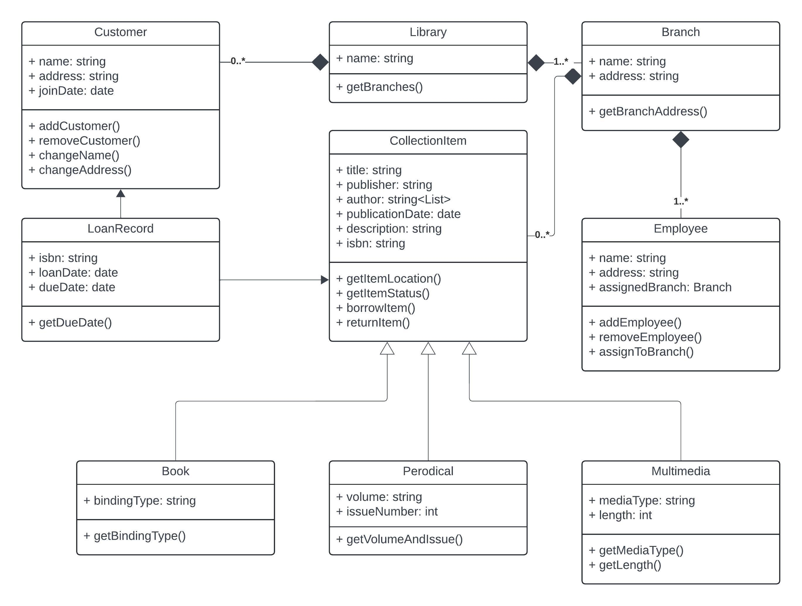

Slide 3
Library has a name and a getBranches() method that returns a list of branches associated with that Library
Branch has a name and address and a getBranchAddress() method that returns the address for that Branch
Employee has a name, address and an assignedBranch. This class has add and remove methods, as well as an assignToBranch() method that creates an association between an Employee record and a Branch. Branches can have multiple Employees but Employees are associated with a single Branch.
Customer has a name, address and joinDate. There are add and remove methods, as well as a change methods for name and address to update those values. A Customer is associated with a Library but not a Branch as they can use any available branch.

Slide 4
CollectionItem represents an item in the library’s collection. It has title, publisher, author, publicationDate, description, and isbn properties. It has the following methods:
getItemLocation() - returns the branch where the item is located
getItemStatus() – indicates whether the item is currently on loan
borrowItem() – creates a LoanRecord when a customer borrows the item
returnItem() – updates the LoanRecord when the item is returned
CollectionItem is extended by three types:
Book, which has a bindingType property and a getBindingType() method
Periodical, which has volume and issueNumber properties and a getVolumeAndIssue() method to return those details (for journals, magazines and other periodicals)
Multimedia, which has mediaType and length properties and get methods for those properties

Slide 5
Finally, we have a LoanRecord class that creates a relationship between a CollectionItem and a Customer when that customer borrows an item. This class has an isbn property to indicate the item, and loanDate and dueDate properties. The getDueDate() method returns the due date so employees can track when an item should be returned.

